Slide 1
Smart Healthcare Appointment
Sequence Diagram

Slide 2
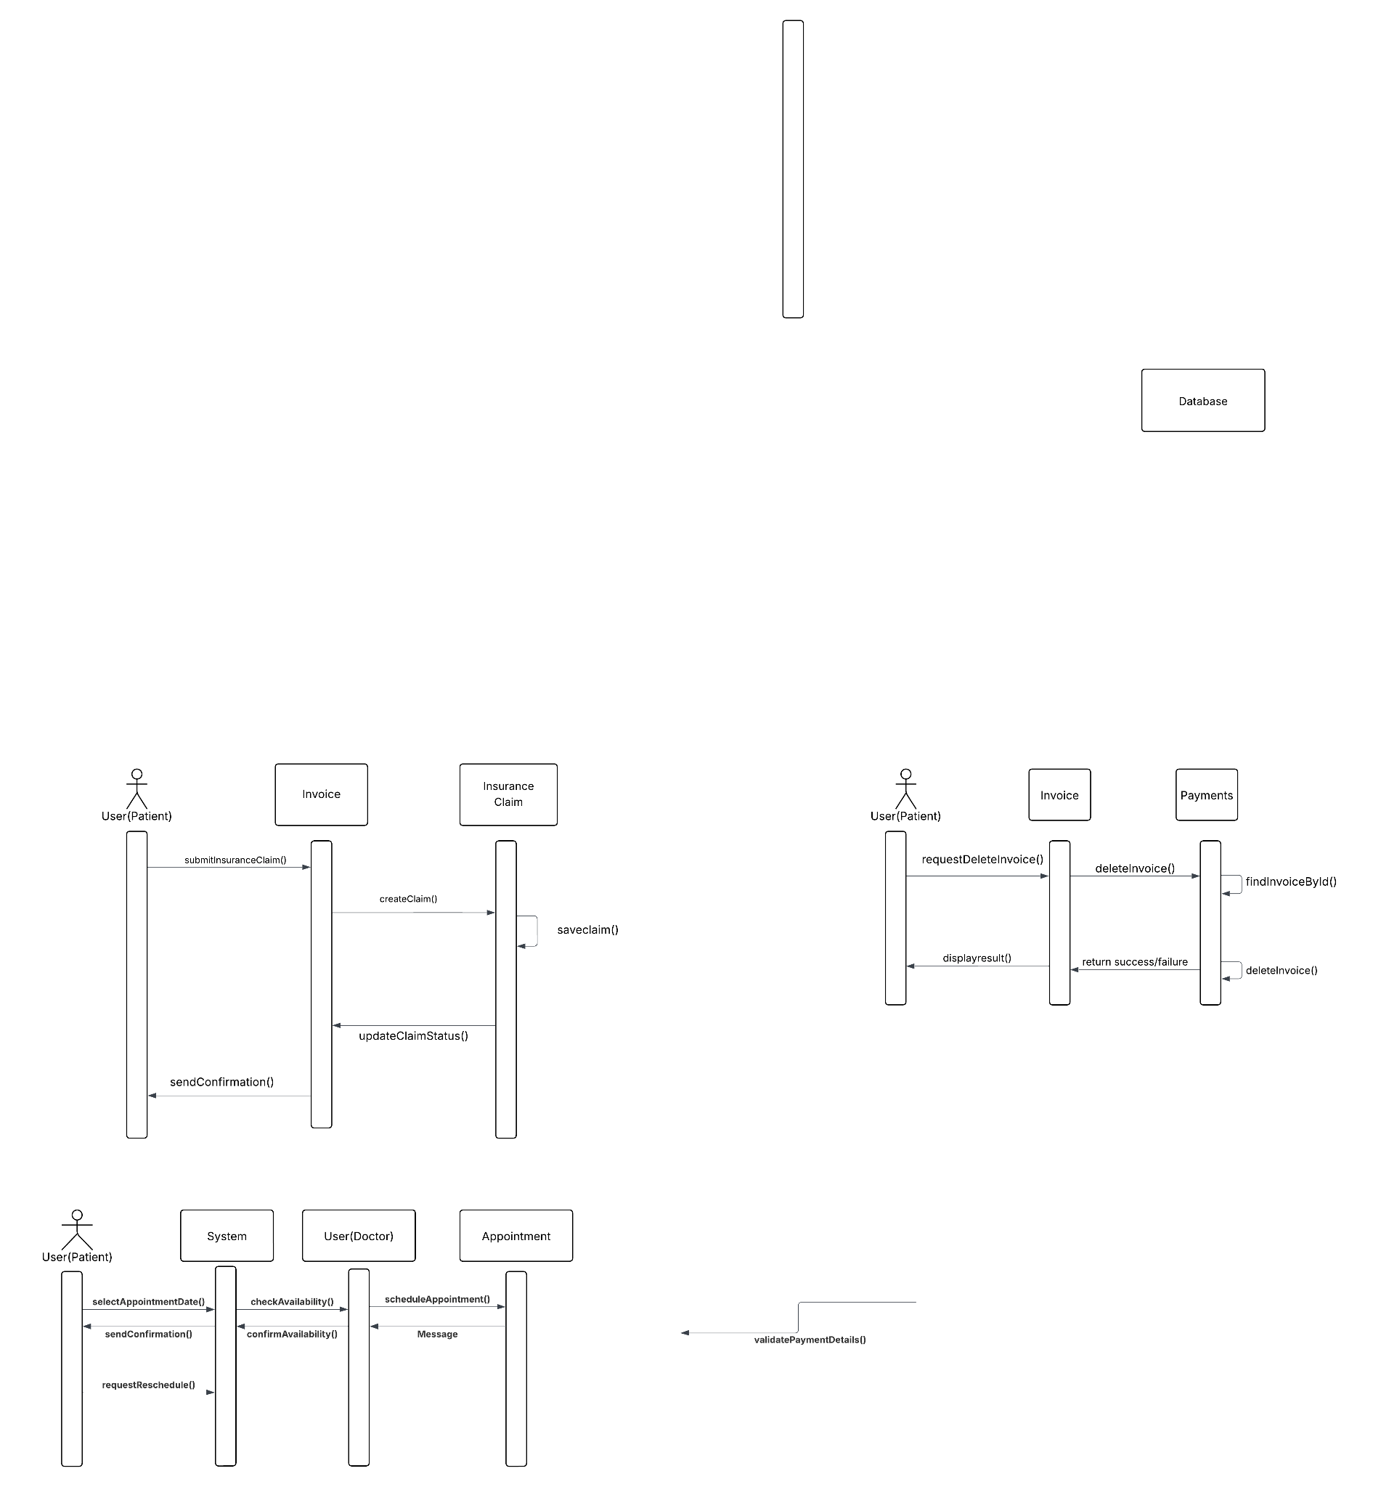
Smart Healthcare Appointment
03.04 Delete Invoice
Use Case Scenario:
The user requests to delete an invoice, which triggers the system to validate the deletion and remove the invoice from the database. The system confirms the successful deletion to the user.

Slide 3
Smart Healthcare Appointment
03.06 Create Insurance Claim
Use Case Scenario:
The patient submits an insurance claim, saving of the claim, followed by a confirmation email to the patient and a success message displayed on the UI.

